Slide 1
MINI PROJECT-I PRESENTATION
ON
IOT Based AIR QUALITY MONITORING SYSTEM
&
INTRODUCTION TO IOT AND ARDUINO
PRESENTED BY: ABHISHANK PANDEY
SECTION-I
UNIVERSITY ROLL.NO-181500011

Slide 2
CONTENTS
1.Introduction
2.Block Diagram
3.Hardware & Software requirements
4.About Arduino UNO Board
5.Working
6.Advantages
7.Applications
8.Future Scope
9.Conclusion

Slide 3
INTRODUCTION
The main objective of this project is to monitor the air pollution in industrial and urban areas.
In this, the Arduino platform is used to communicate the data simply and quickly.
WSN(Wireless Sensor Network)acts as the transreceiver communication technology.
The projected monitoring system can be transferred to or shared by different applications. Through IOT we can able to visualize the values from the globe.
Keywords-Wireless Sensor network(WSN),Air quality Monitoring System(AQMS),Gas sensors(MQ series or CO)

Slide 4
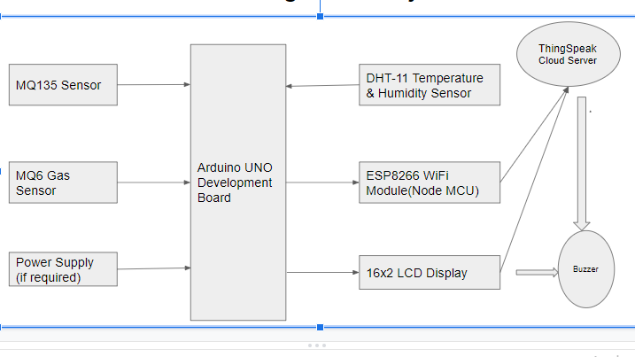
BLOCK DIAGRAM

Slide 5
HARDWARE REQUIREMENTS
1. MQ135 Gas sensor
2.Arduino Uno(ATMEGA 328P microcontroller)
3.Wi-Fi module ESP8266
4.Breadboard
5.Buzzer
6.10K potentiometer
7. 1K ohm resistors
8.220 ohm resistor
9.MQ 6 LPG gas sensor
10. Temperature & Humidity Sensor(DHT-11)

Slide 6
SOFTWARE REQUIREMENTS
1.Arduino UNO 1.6.13 Software
2.Embedded C programming Language
3.ThingSpeak cloud data server for displaying the output of the project.

Slide 7
ABOUT ARDUINO UNO BOARD
Arduino is a open-source microcontroller hardware board.
It is based on the microchip AT MEGA 328P microcontroller and is developed by Arduino.cc
Arduino microcontrollers are pre-programmed with a boot loader that simplifies uploading of programs to the on-chip flash memory. Boards are loaded with a program code via a serial connection to computer.
The board is equipped with sets of digital and analog input/output (I/O) pins that may be interfaced to various expansion boards (shields) and other circuits.
The board has 14 digital I/O pins (six capable of PWM output), 6 analog I/O pins, and is programmable with the Arduino IDE (Integrated Development Environment), via a type B USB cable.

Slide 8
It can be powered by the USB cable or by an external 9-volt battery, though it accepts voltages between 7 and 20 volts.
The word "uno" means "one" in Italian and was chosen to mark the initial release of Arduino Software. The Uno board is the first in a series of USB-based Arduino boards

Slide 9
TECHNICAL SPECIFIATIONS
Microcontroller: Microchip ATmega328P
Operating Voltage: 5 Volts
Input Voltage: 7 to 20 Volts
Digital I/O Pins: 14 (of which 6 can provide PWM output)
Analog Input Pins: 6
DC Current per I/O Pin: 20 mA
DC Current for 3.3V Pin: 50 mA
Flash Memory: 32 KB of which 0.5 KB used by bootloader
SRAM: 2 KB
EEPROM: 1 KB
Clock Speed: 16 MHz
Length: 68.6 mm
Width: 53.4 mm
Weight: 25 gm

Slide 10
WORKING
The data of air is recognized by MQ135 gas sensor and MQ6 LPG gas sensor. The MQ135 sensor can sense NH3, NOx, alcohol, Benzene, smoke, CO2. So it is dynamic gas sensored for our Air pollution Monitoring system. When it will be connected to Arduino then it will sense all gases, and it will give the Pollution level in PPM (parts per million). MQ135 gas sensor will give the output in form of voltage levels and we have to convert it into PPM. So for converting the output in PPM, we have used a library for MQ135 gas sensor and MQ6 sensor.
Sensor is giving us value of 90 when there is no gas near it and the air quality safe level is 350 PPM and it should not exceed 1000 PPM. When it will exceed the limit of 1000 PPM, it will cause Headaches, sleepiness and stagnant, stuffy air. If it exceeds beyond 2000 PPM then it will cause increased heart rate and many different diseases. When the value will be less than 1000 PPM, then the LCD and webpage will display “Fresh Air”. When the value will increase from 1000 PPM, then the buzzer will start beeping and the LCD and webpage will display “Poor Air, Open Windows”. And when it will increase 2000, the buzzer will keep beeping and give an alert message on smartphone through GSM. The LCD and webpage will display “Danger! Move to fresh Air”. It will contain temperature and humidity so it will possibly show the current temperature and humidity of the air. For temperature we have used LM35 sensor and for humidity SY-HS-220 or DHT-11 sensor.For my easy purpose, I am using DHT-11 which is both a temperature as well as humidity sensor.
According to the model the 4 sensors works as input data, they transmit data for knowing which gas it is, what is the temperature and humidity. LCD and Buzzer are the output devices. LCD shows the data of the gases in ppm (parts per million) and Buzzer is used when ppm crosses above a threshold limit.

Slide 11
ADVANTAGES
Sensors are easily available.
Detecting a wide range of gases such as CO2,CO,Methane(CH4),smoke, etc.
Simple,compact and easily handle.
Continuous update of change in percentage of air quality.

Slide 12
APPLICATIONS
Roadside pollution monitoring
Industrial perimeter monitoring
Site selection for reference monitoring stations.
Indoor air quality monitoring

Slide 13
FUTURE SCOPE
In future the project can be upgraded in more ways than one.
Interface more number of sensors to know different gases present in the air.
Design a webpage and upload data on the webpage.
Inerface SD card to store data.
Interface the GPS module to monitor the pollution.

Slide 14
CONCLUSION
The system is used to monitor the air of environment using arduino microcontroller.
IOT technology proposed to improve the quality of the air in big cities where this problem is in demand at high level and certain measures/steps to improve it.
It supports new technology and healthy life concept.

Slide 15
THANK YOU

